Slide 1

SUBJECT CODE
TYPE THE SUBJECT NAME HERE
DECENTRALISED NETWORK USING BLOCK CHAIN
DATE: 15.11.2021
BATCH NUMBER : <TEAM ID>
PROJECT CODE : SEC24ITTE30101
BATCH MEMBER : AJAAY A P , PRAKASH A
SUPERVISOR : Mrs.SARANYA
II
III
20ITTE301- LIVE IN LAB

Slide 2
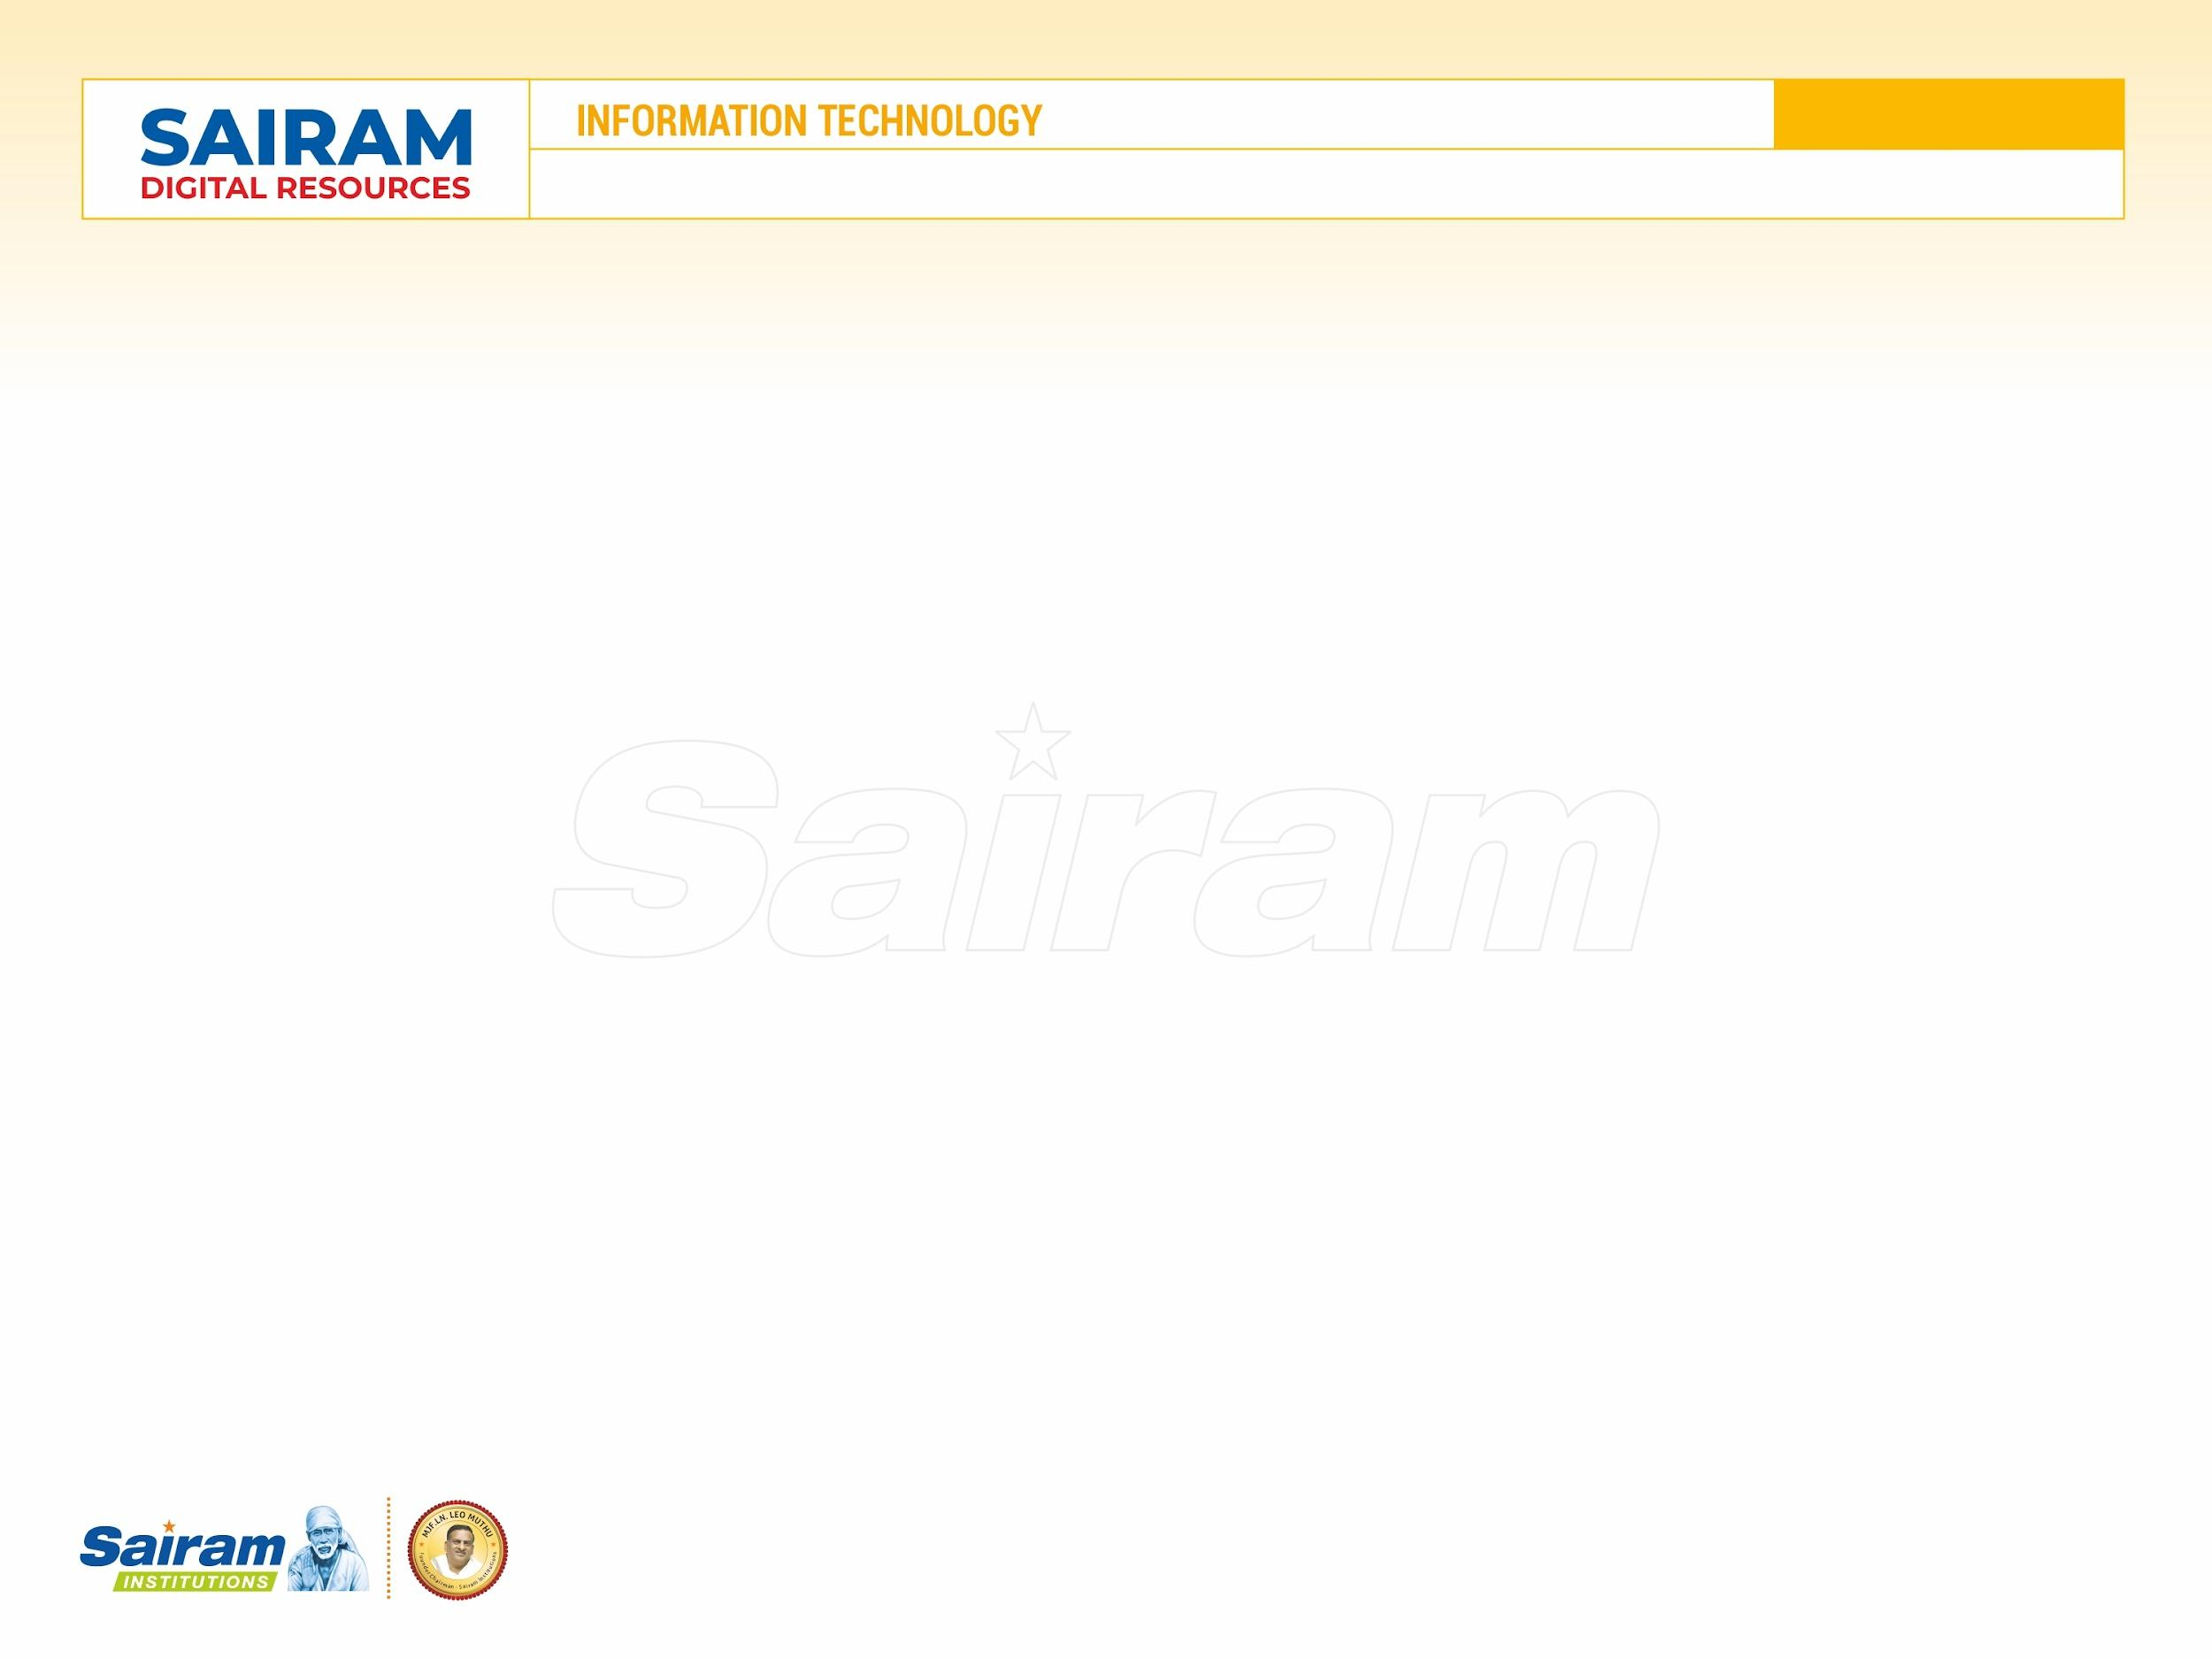
20ITTE301
LIVE IN LAB
INTRODUCTION
Today’s fast growing technologies are more effective and are adaptable to people.
But it has some challenging problems in the view of security and reliability
We have come with the idea of block chain and Decentralisation to fix these problems and a future scope of online transcations
In near future , this becomes a promising platform for transcations if implemented.

Slide 3
20ITTE301
LIVE IN LAB
Literature Review
S.No. | Journal Details | Authors & Title of the Paper | Work carried out | Inference of the Paper
1. | International Research Journal on Advanced Science Hub, 2020, | KohilaKanagalakshmi T Ms. Lavita Shweta Biradar A Conceptual Study of Blockchain to Financial Sector | All the nodes in the system receive the connections and it is tested for accept or reject the transactions. Once the nodes accept the block it will be added to the blockchain network with the help of its hash value | A basic block chain transactions is inferred here.
2. | Decentralised Linux Research , 2001 | George N. Dafermos Management and virtual decentralised networks: The Linux project ( published in Volume 6, Number 11/2001) | This is the first decentralisation network proposed by Linux. The Linux Project and its development model are selected as a case of analysis and the critical success factors of this organisational design are identified. | The idea of Linux to propose decentralised network.

Slide 4
S.No. | Journal Details | Authors & Title of the Paper | Work carried out | Inference of the Paper
3. | 2020 International Conference for Emerging Technology (INCET) | Decentralised Blockchain Technology: Application in Banking Sector Sameer Khan | The technology could remove trusted third parties, decrease costs and ultimately increase profits for various players within the industry. In the field of payment transactions, it could reshape the current correspondent banking processes and lead to cost savings. In trade finance, it improves the segment by providing trust, security, risk mitigation and fast processes at low costs
4. | Financial Stability Board (FSB). 2019 | Current examples of technologies that enable financial decentralisation | Distributed ledger technology (DLT) enables the decentralisation of record-keeping. It does so by removing the need for a central ledger in which to record financial transaction. Online peer-to-peer (P2P), or user-matching, platforms allow users to interact directly and decentralise their task | Emerging applications of this idea are inferred. (Examples: Amazon)

Slide 5
S.No. | Journal Details | Authors & Title of the Paper | Work carried out | Inference of the Paper
5. | 2020 Interational Conference for Emerging Technology (INCET) 5-7 June 2020 | Nikita Rajeshkumar Bagrecha Rishabh Sharma Pragya Abhai Mehrotra Decentralised Blockchain Technology: transcation process. | the banking systems can update from their traditional methodologies to a digital, immutable, distributed ledger that can be implemented via Blockchain Blockchain Technology is a distributed peer to peer linked structure which can solve the problem of maintaining and recording transactions in a banking system | An Overview of transaction using Decentralised block chain is inferred
6. |  | Payment processing using decentralised and block chain technology | If a person needs to send money,the transaction is represented as a block Then, the block is broadcasted to every party in the network It’s approved to only if the block is valid to the network Then the block is added to the chain which provides transparent record of transcations. Then the money is transferred. | A clear view on block chain transactions is displayed
14th International Scientific
Conference
June 26-27, 2017

Slide 6
S.No. | Journal Details | Authors & Title of the Paper | Work carried out | Inference of the Paper
7. | Published: 27 February 2021 | Sk. Md. Mizanur Rahman and Ahad ZareRavasan Designing a Digital Ledger (DLT) | A exhaustive Knowledge about the business model and decentralised application is required. Understanding the existing system and what benificary outcomes is required. Understanding each tier and finding absolutue solution for each tier | Design of a digital ledger is inferred.
8. | June 26-27, 2017 Josef Nešleha Tomáš Plíhal Karel Urbanovský | European Financial Systems 2017 Proceedings of the 14 th International Scientific Conference Advantages of DLT | Reduction in cost/time Security/ privacy improvements Slimmer procedures Easier data management Lower risk, instant processing | Functions peformed, advantages are inferred.

Slide 7
S.No. | Journal Details | Authors & Title of the Paper | Work carried out | Inference of the Paper
9. | 2021-11-02 Sonal Trive di, Kiran Mehta, Renuka Sharma | Summary of Blockchain Technology in E-Finance and Financial Services | This research reveals that the majority of the literature on financial services and e-finance are focused on cryptocurrencies majorly in the stream of economics and computer science. Thus, the most common blockchain applications are cryptocurrencies, despite the fact that it was created as a technology product. Bitcoin is the most popular of them, both in the market and in literature. Blockchain has the potential to permit peer-to-peer transactions, widen tran-saction possibility, lesser transaction costs and piloting in a new era of decentralised business models. As a result of this new paradigm, decentralised finance has evolved, which employs blockchain techno-logy to create an alternative financial system that is more borderless | Analysed survey of blockchain in banking and financial furnished.

Slide 8
S.No. | Journal Details | Authors & Title of the Paper | Work carried out | Inference of the Paper
9. | International Journal of Advanced Computer Research (2019) | Al-Amri, Redhwan and Zakaria, Nur Haryani and Habbal, Adib M. Monzer and Hassan, Suhaidi (2019) Cryptocurrency adoption: current stage, opportunities, and open challenges | Cryptocurrency is attracting the attention of academic and non- academic researchers as an alternative architecture of currency. 2. Transactions are verified using Blockchain that enables a block and check in the network 3. Blockchain transactions are decentralized, meaning they're spread across many computers to manage and record transactions 4. Examples :Bitcoin | An intro of Cryptocurrency is inferred.

Slide 9

PROPOSED ARCHITECTURE
Main Server
Bill Payment
Deposit
Fund Transfer

Slide 10
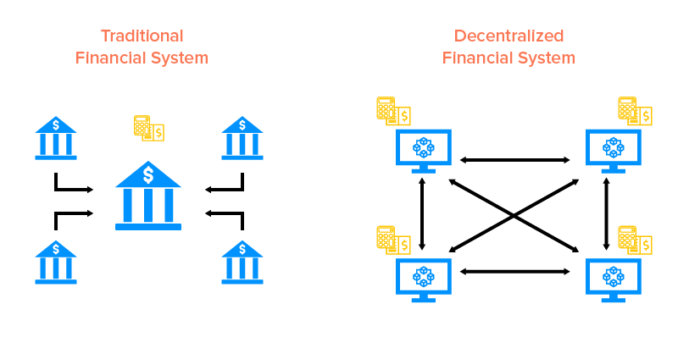
Modules

Slide 11
Timeline
A complete view about block chain and decentralised network
Testing and Feedback
Designing a Digital Ledger
1 month
1 month
15 days
Total Sparring of Time : 2months 15 days

Slide 12
20ITTE301
LIVE IN LAB
REFERENCES
http://doi.org/10.19101/IJACR.PID43
https://www.sciencedirect.com/science/article/pii/S108480452030130
APPLICATIONS OF BLOCKCHAIN TECHNOLOGY IN BANKING & FINANCE Tejal Shah 1, Shailak Jani 2, Under the guidance of Dr. P K Priyan (Professor @ GHPIBM dept Management Studies) Assistant Professor 1, Post Graduate Student 2, Faculty of Management Studies 1, 2, Parul University, Vadodara, India.
Distributed Ledger Technology Review and Decentralized Applications Development Guidelines Computer Science Department, Technical University of Cluj-Napoca, Memorandumului 28, 400114 Cluj-Napoca, Romania
Systematic Literature Review on Application of Blockchain Technology in E-Finance and Financial Services Chitkara Business School, Chitkara University, Punjab, India
Blockchain-applications in banking & payment transactions: Results of a survey
Beyond Cryptocurrencies - A Taxonomy of Decentralized Consensus Systems
23rd European Conference on Information Systems (ECIS), Münster, Germany, 2015
A Survey of Blockchain Applications in Different Domains https://doi.org/10.1145/3301403.3301407

Slide 13
THANK YOU

